Slide 1

Data Analysis Using MySQL
Capstone project
Bhagyashree More
Enrollment ID-EN12024077896

Slide 2
Sakila DataBase
Sakila is a movie rental store with a vast collection of movies in DVDs and blue ray disc formats.
This Motion Picture Data Analysis is performed on Sakila DataBase.
Based on data different task analysis need to done to obtain the desired output.
As per the tables and data in Sakila Database few such Analysis were done

Slide 3
Objective
The objective of the project is to use MySQL to analyze the data of a movie rental store for further growth and improved business.

Slide 4
Content
Task 1: Display the full names of actors available in database
Task 2: Display the number of times each first names appears in the database
What is the count of actors that have unique first names in db? display the first name of all these actor.
Task 3: Display the number of times each last name appears in the db.
Display all unique last names in the db.
Task 4: Display the list of records from movies with the rating "R“.
Display the list of records from movies that are not rating "R“
Display the list of records for the movies that are suitable for audience below 13 years of age.
Task 5: Display the list of records for the movies where the replacement cost is up to $11.
Display the list of records for the movies where the replacement cost is between $11 and $20.
Display the list of records for the movies in descending order of their replacement costs.
Task 6: Display the names of the top 3 movies with the greatest number of actors.
Task 7: Display the titles of the movies starting with letter 'K' and 'Q’
Task 8: The film 'Agent Truman' has been a great success. display the names of all actors who appeared in this film.
Task 9: Identify and display the names of the movies in the family category.
Task 10: Display the maximum, minimum and average rental rates of movies based on their rating. the output must be sorted in descending order of the average rental rates.
display the names of the most frequently rented movies in descending order, so that the management can maintain more copies of such movies.
Task 11: Calculate and display the number of movie categories where the average between the movie replacement cost and the rental rate is greater than $15.
Task 12: Display the film categories in which the number of movies is grater than 70.

Slide 5
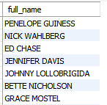
Task 1: Display the full names of actors available in database
QUERY
select concat(first_name,' ',last_name) as full_name from actor;
Result
Conclusion:
Using the Sakila Database using concat method to join 2 column.

Slide 6
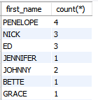
Task 2.i: Display the number of times each first names appears in the database.
QUERY
select first_name,count(*) from actor group by first_name;
Result
Conclusion:
Using the Sakila Database using group by clause to display count of firstname. Penelope, nick, ED name appears 4,3,3 times.

Slide 7
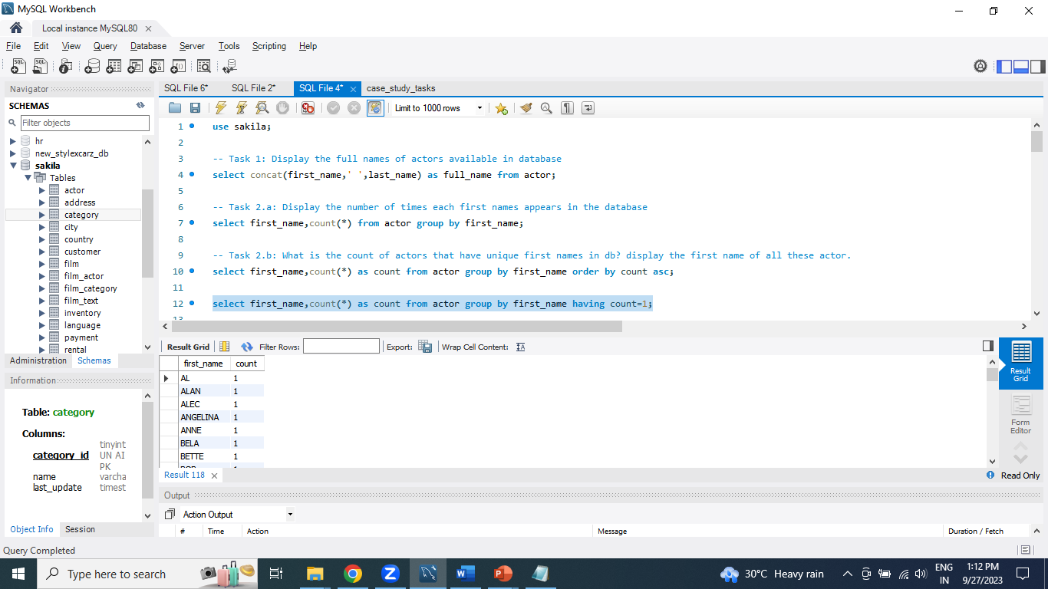
Task 2.ii: What is the count of actors that have unique first names in db? display the first name of all these actor.
QUERY
select first_name,count(*) as count from actor group by first_name having count=1;
Result
Conclusion:
Above result shows the unique first name using group by and having condition.

Slide 8
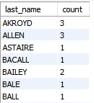
Task 3.i: Display the number of times each last name appears in the db.
QUERY
select last_name,count(*) as count from actor group by last_name;
Result
Conclusion:
Above result shows the last name appears multiple times using group by clause.

Slide 9
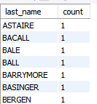
Task 3.ii: Display all unique last names in the db.
QUERY
select last_name,count(*) as count from actor group by last_name order by count asc;
Result
Conclusion:
Astaire, Bacall, Bale, Ball, Barrymore, Basinger and Bergen is unique lastname.

Slide 10
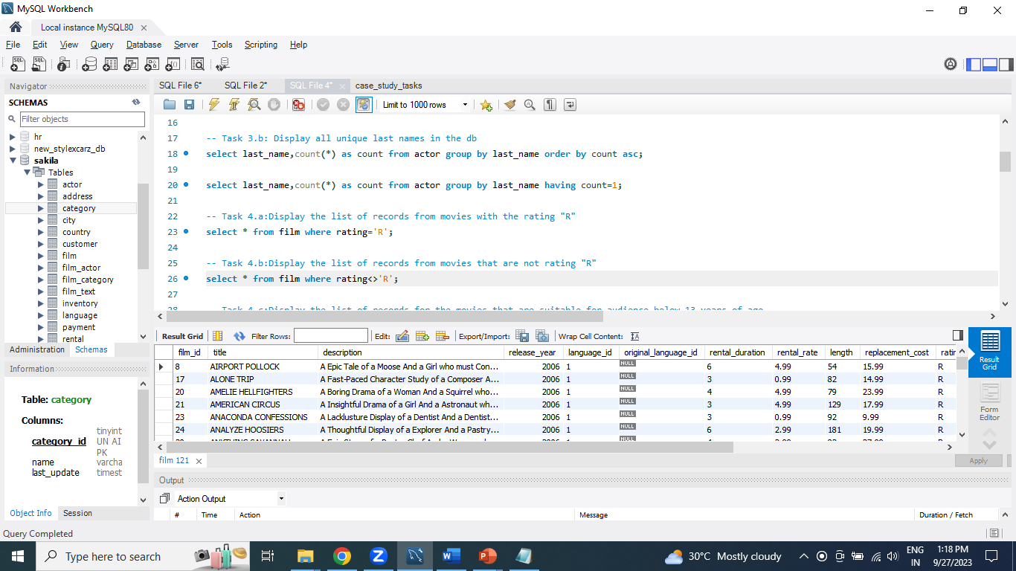
Task 4.i: Display the list of records from movies with the rating "R"
QUERY
select * from film where rating='R';
Result
Conclusion:
Using the Sakila Database using where clause for condition where rating is R. there are 195 movies with R rating..

Slide 11
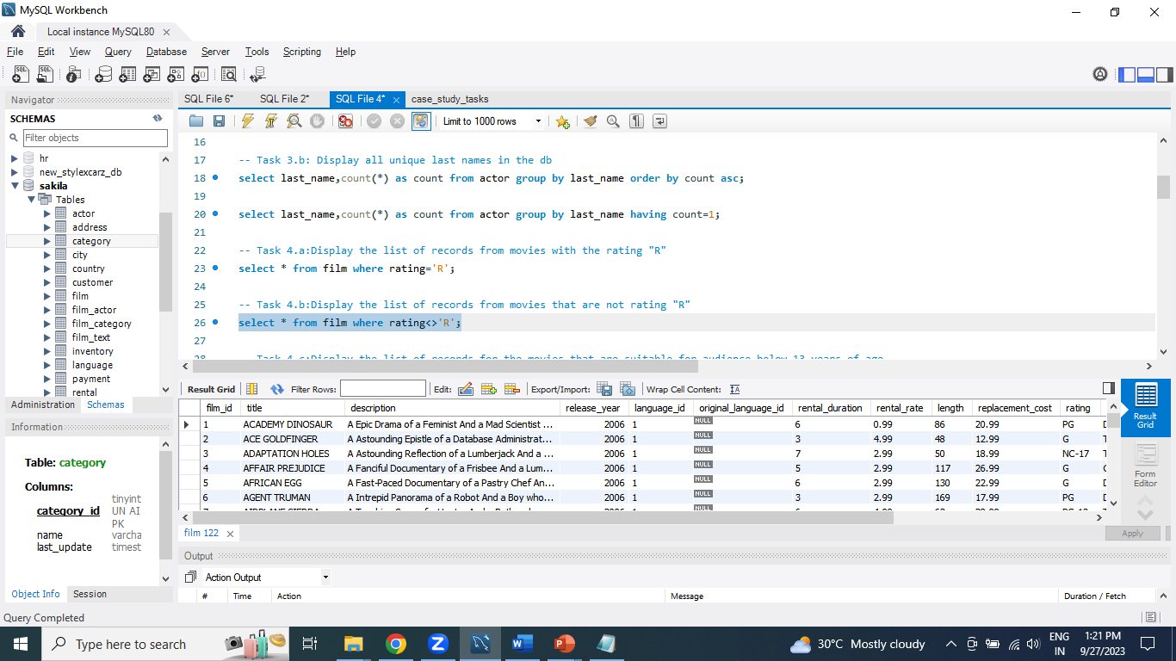
Task 4.ii: Display the list of records from movies that are not rating "R"
QUERY
select * from film where rating<>'R';
Result
Conclusion:
Using the Sakila Database using where clause for condition where rating is not R. There are 805 records that are not rating ‘R’.

Slide 12
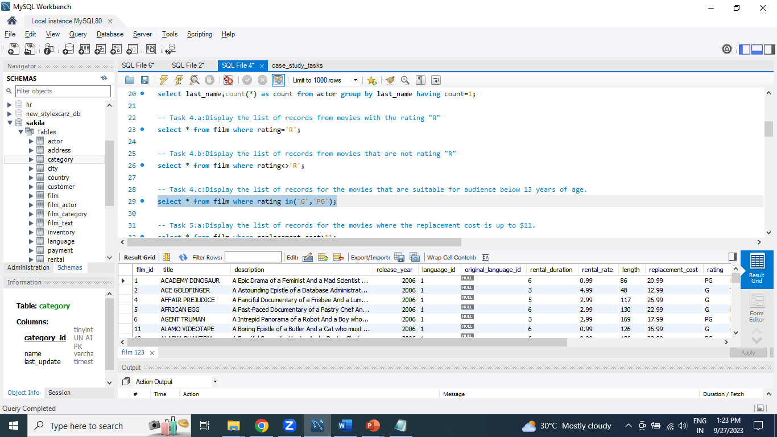
Task 4.iii: Display the list of records for the movies that are suitable for audience below 13 years of age.
QUERY
select * from film where rating in('G','PG');
Result
Conclusion:
Using the Sakila Database using where clause with IN operator for multiple values. 372 movies suitable for audience below 13 years of age.

Slide 13
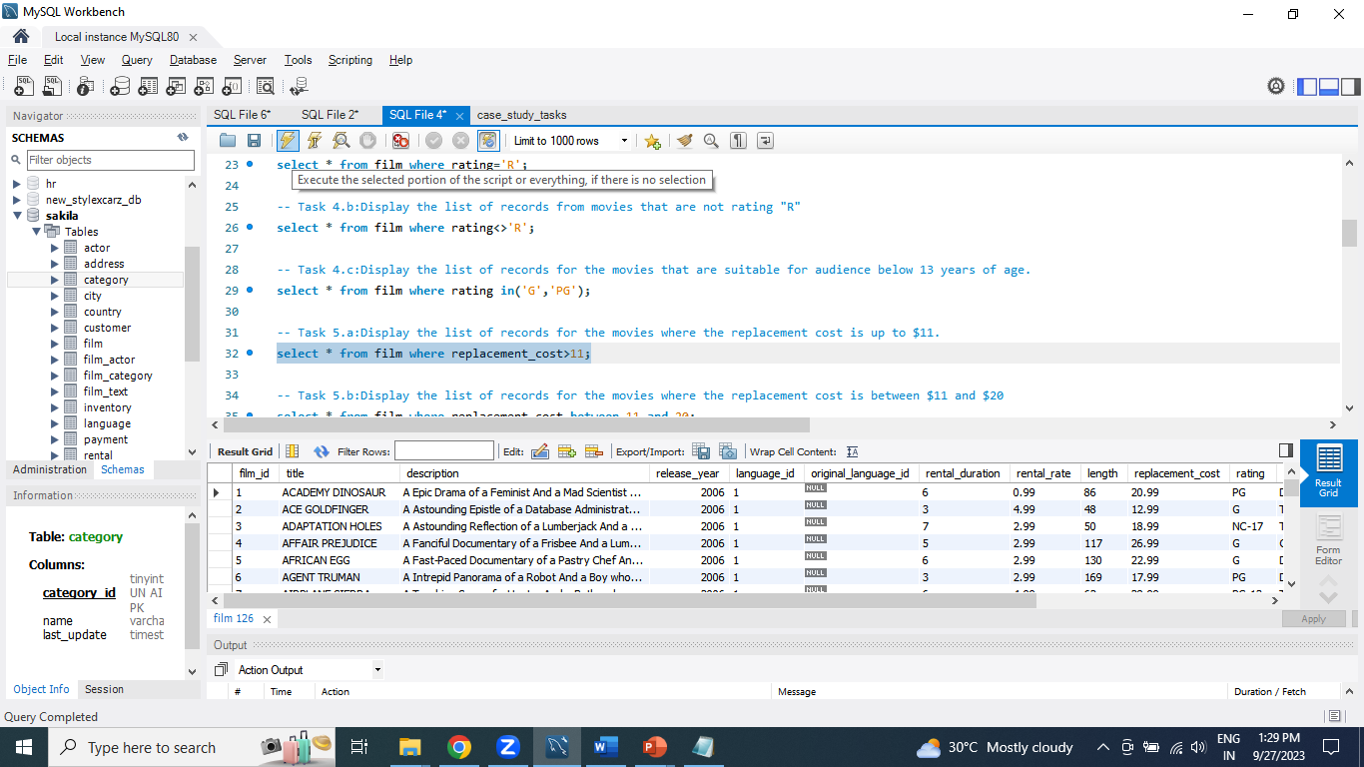
Task 5.i: Display the list of records for the movies where the replacement cost is up to $11.
QUERY
select * from film where replacement_cost>11;
Result
Conclusion:
Using the Sakila Database using where clause with greater than operator for display records.910 movies have replacement cost is up to $11.

Slide 14
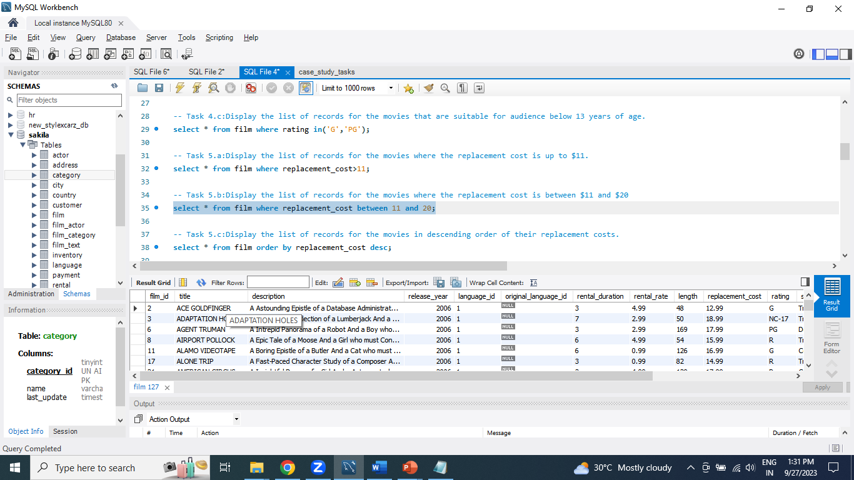
Task 5.ii: Display the list of records for the movies where the replacement cost is between $11 and $20
QUERY
select * from film where replacement_cost between 11 and 20;
Result
Conclusion:
Using the Sakila Database using where clause with between operator for display records. 424 movies have replacement cost is between $11 & $20.

Slide 15
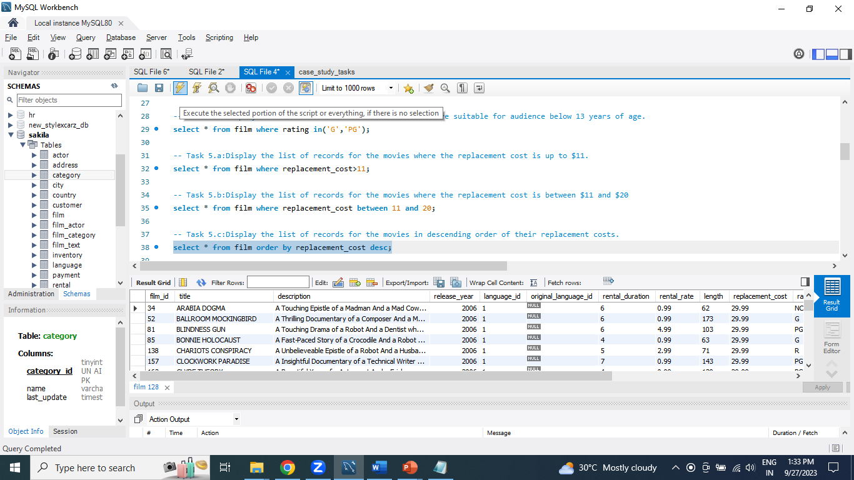
Task 5.iii: Display the list of records for the movies in descending order of their replacement costs.
QUERY
select * from film order by replacement_cost desc;
Result
Conclusion:
Using the Sakila Database using order by clause with replacement_cost descending for display records. highest replacement cost is 29.99

Slide 16
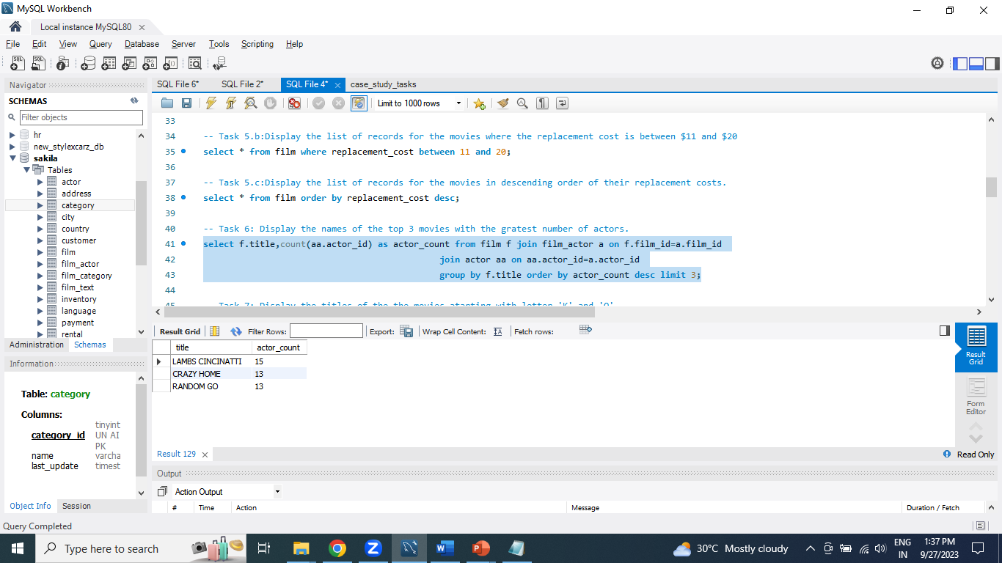
Task 6: Display the names of the top 3 movies with the greatest number of actors.
QUERY
select f.title,count(aa.actor_id) as actor_count from film f join film_actor a on f.film_id=a.film_id join actor aa on aa.actor_id=a.actor_id group by f.title order by actor_count desc limit 3;
Result
Conclusion:
Using the Sakila Database using join concept to display top 3 movies with the greatest number of actors. There are LAMBS Cincinatti, Crazy Home and Random Go have greatest number of actors.

Slide 17
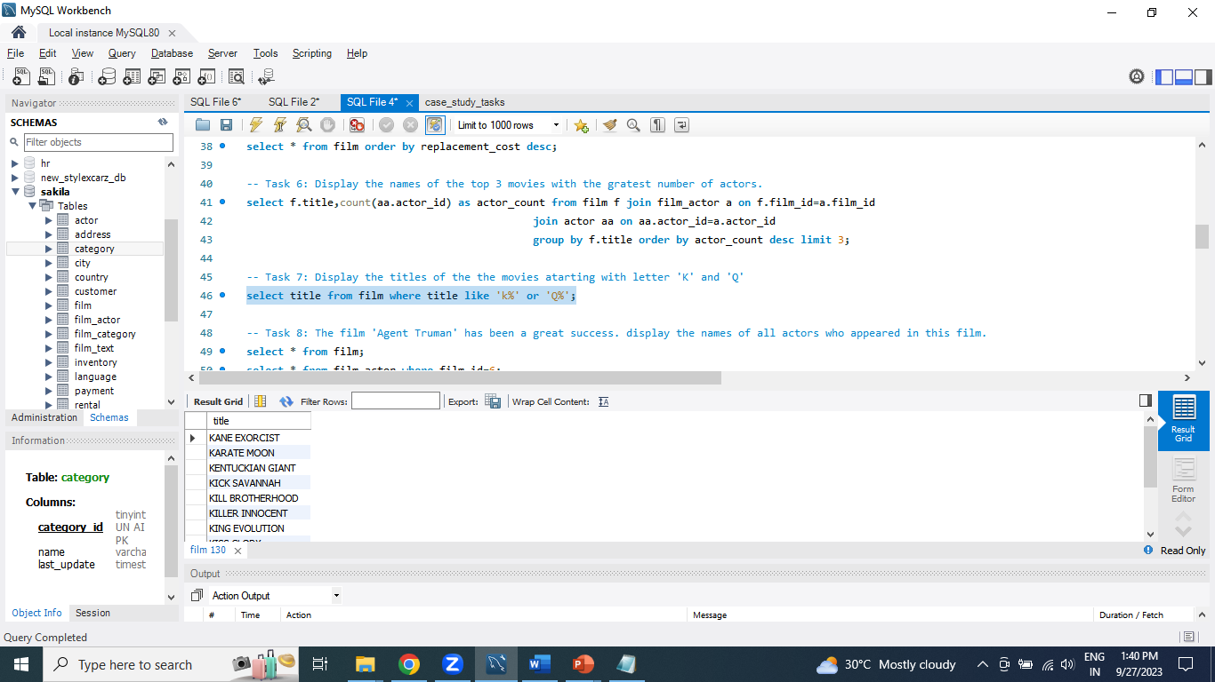
Task 7: Display the titles of the movies starting with letter 'K' and 'Q'
QUERY
select title from film where title like 'k%' or 'Q%';
Result
Conclusion:
Using the Sakila Database display the 12 movies starting with letter 'K' and ‘Q’ using like keyword.

Slide 18
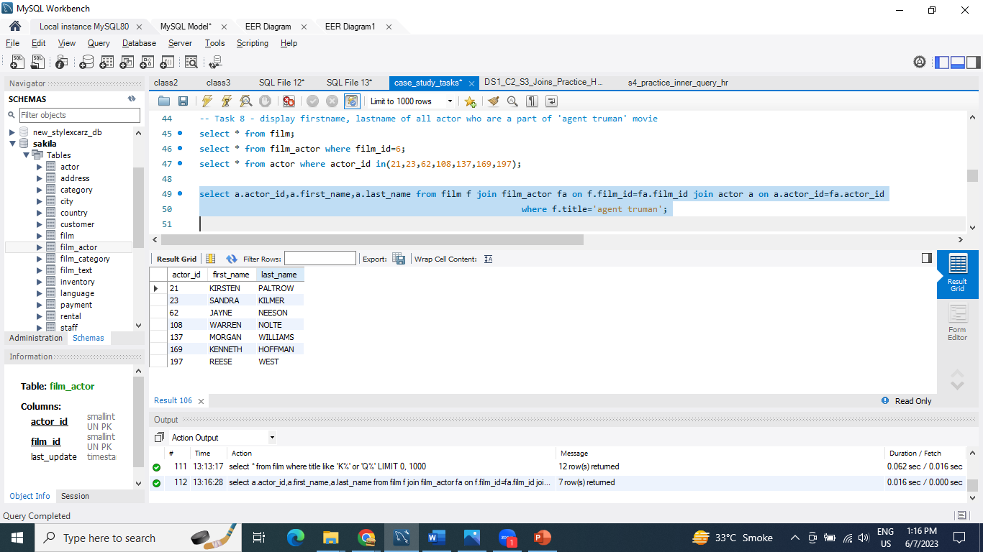
Task 8: The film 'Agent Truman' has been a great success. display the names of all actors who appeared in this film.
QUERY
select a.actor_id,a.first_name,a.last_name from film f join film_actor fa on f.film_id=fa.film_id join actor a on a.actor_id=fa.actor_id where f.title= 'agent truman';
Result
Conclusion:
Using the Sakila Database 7 actors work in ‘Agent Truman’ movie.

Slide 19
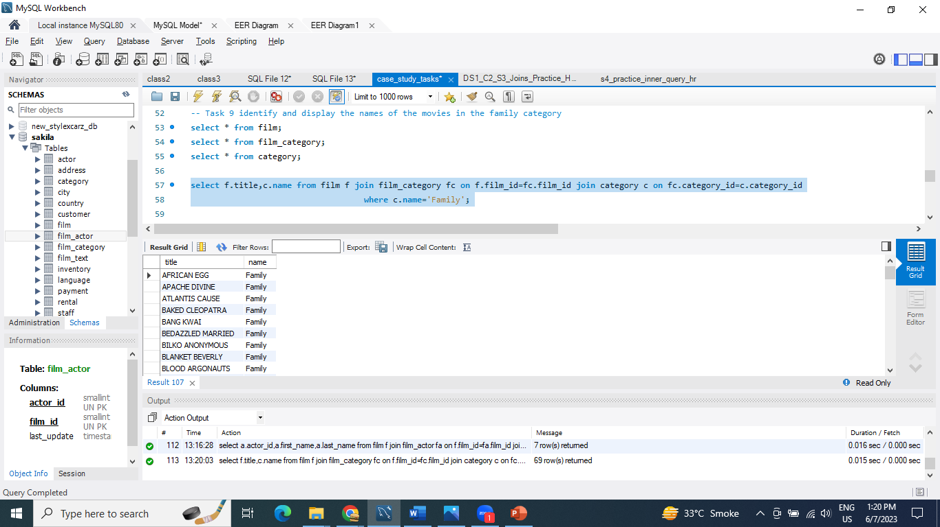
Task 9: Identify and display the names of the movies in the family category
QUERY
select f.title,c.name from film f join film_category fc on f.film_id=fc.film_id join category c on fc.category_id=c.category_id where c.name='Family';
Result
Conclusion:
Using the Sakila Database display the name of movie in family category. 69 movies in the family category.

Slide 20
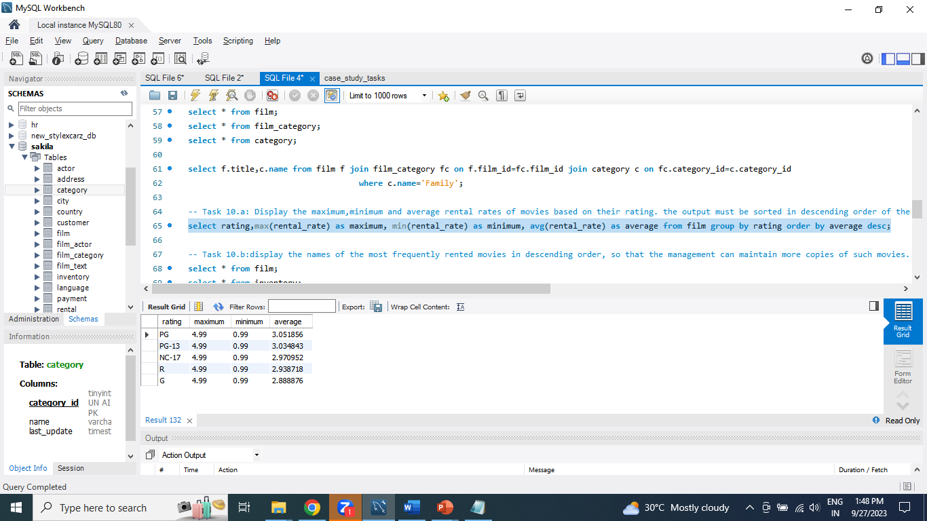
Task 10.i: Display the maximum, minimum and average rental rates of movies based on their rating. the output must be sorted in descending order of the average rental rates.
QUERY
select rating,max(rental_rate) as maximum, min(rental_rate) as minimum, avg(rental_rate) as average from film group by rating order by average desc;
Result
Conclusion:
Maximum rating is 4.99, Minimum rating is 0.99 and average rating is 3.05.

Slide 21
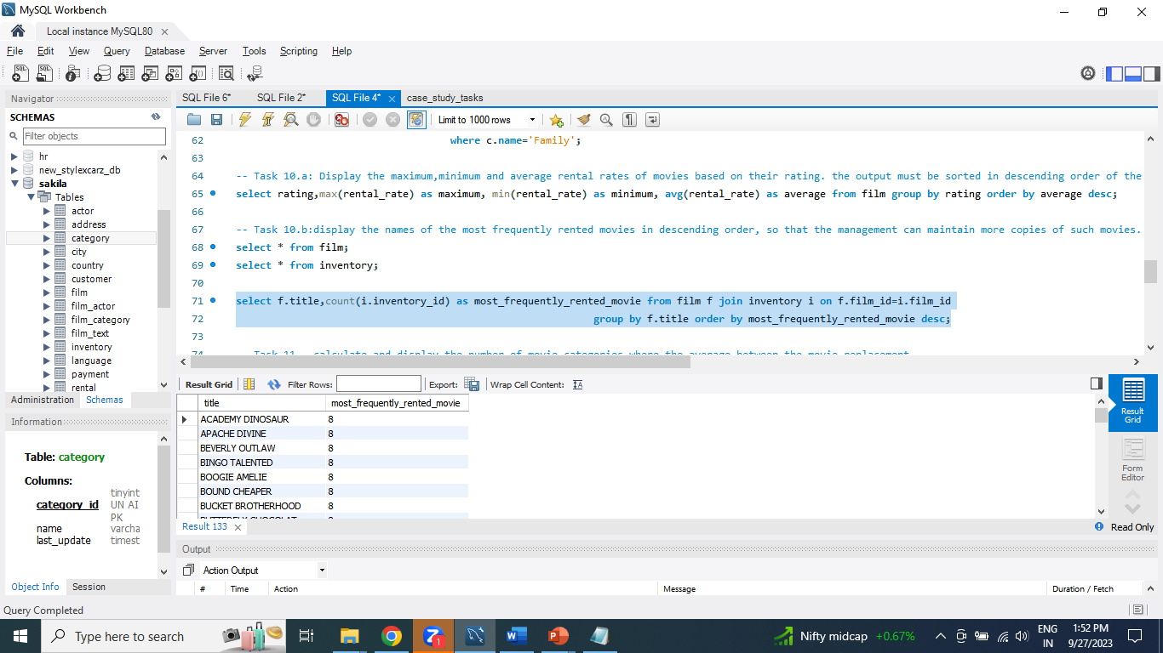
Task 10.ii: display the names of the most frequently rented movies in descending order, so that the management can maintain more copies of such movies.
QUERY
select f.title,count(i.inventory_id) as most_frequently_rented_movie from film f join inventory i on f.film_id=i.film_id group by f.title order by most_frequently_rented_movie desc;
Result
Conclusion:
Using the Sakila Database display most frequently rented movie.

Slide 22
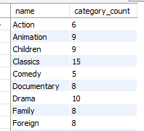
Task 11: calculate and display the number of movie categories where the average between the movie replacement cost and the rental rate is greater than $15
QUERY
SELECT c.name,COUNT(*) AS category_count FROM film f JOIN film_category fc ON fc.film_id = f.film_id JOIN category c ON c.category_id = fc.category_id WHERE (f.replacement_cost + f.rental_rate) / 2 > 15 group by c.name;
Result
Conclusion:
Using the Sakila Database display the number of movie categories where the average between the movie replacement cost and rental rate is greater than $15.

Slide 23
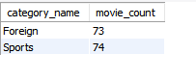
Task 12: Display the film categories in which the number of movies is greater than 70.
QUERY
SELECT c.name AS category_name, COUNT(fc.film_id) AS movie_countFROM category cJOIN film_category fc ON c.category_id = fc.category_idGROUP BY c.nameHAVING COUNT(fc.film_id) > 70;
Result
Conclusion:
Foreign and sports category have movie count grater than 70.

Slide 24

Conclusion
In conclusion, using MySQL for data analysis in a movie rental store project offers the potential to enhance business operations, drive growth, and improve customer satisfaction.
By leveraging data-driven insights, the project can lead to more informed strategies and ultimately contribute to the success of the rental store business.

Slide 25

Thank You

